Slide 1
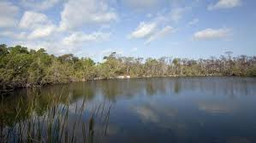
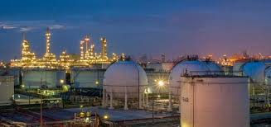
Resource and Development

Slide 2
What is Resource?
Anything present in our environment which can be used to satisfy our needs, provided it is technologically accessible, economically feasible and culturally acceptable is called a RESOURCE.

Slide 3
PHYSICAL ENVIRONMENT
(NATURE)
HUMAN BEINGS
TECHNOLOGY
INSTITUTIONS

Slide 4
IT SIMPLY MEANS :
HUMAN BEINGS INTERACT WITH NATURE THROUGH TECHNOLOGY AND CREATE INSTITUTIONS TO ACCELERATE THEIR ECONOMIC DEVELOPMENT

Slide 5
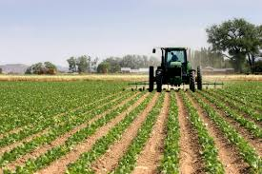
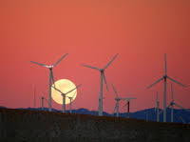
HUMAN BEINGS INTERACTS WITH NATURE TO CREATE RESOURCES

Slide 6
CLASSIFICATOIN OF RESOURCE
RESOURCE
NATURAL
RENEWABLE
NONRENEWABLE
HUMAN
STRUCTURES AND INSTITUTIONS
QUANTITY AND QUALITY

Slide 7
RESOURCE
RENEWABLE
NONRENEWABLE

Slide 8
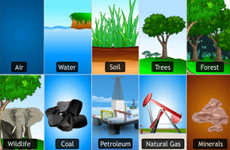
SOME MORE EXAMPLES
RENEWABLE
NON RENEWABLE

Slide 9
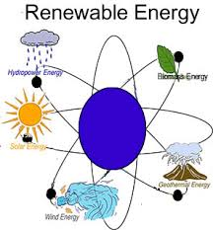
RENEWABLE RESOURCE
THEY CAN BE RENEWED OR REPRODUCED BY PHYSICAL,CHEMICAL OR MECHANICAL PROCESSES.

Slide 10
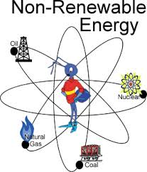
NON RENEWABLE RESOURCE
THESE TAKE MILLIONS OF YEARS FOR THEIR FORMATIONAND HENCE CANNOT BE EASILY RECYCLED OR REPRODUCED.
THEY ARE EXHAUSTIBLE

Slide 11
RESOURCE DEPLETION
MAJOR PROBLEMS
INDISCRIMINATE USE OF RESOURCES
DEPLETION OF RESOURCES FOR SATISFYING THE GREED OF A FEW INDIVIDUALS
ACCUMALATION OF RESOURCES IN A FEW HANDS
GLOBAL ECOLOGICAL CRISIS LIKE GLOBAL WARMING,ENVIRONMENTAL POLLUTION AND LAND DEGRADATION

Slide 12
NEED OF THE HOUR
RESOURCE PLANNING
SUSTAINABLE DEVELOPMENT
EQUITABLE DISTRIBUTION OF RESOURCE

